Slide 1


Modelling and simulation using Matlab/Simulink and its applications in Electric Power Steering sytem
Faculty of Transportation Engineering
Ho Chi Minh City University of Technology
Part of “Study of MATLAB/Simulink and application on simulation and analysis of mechanical components of the (complete) EPS system
Instructor: Dr. Ngô Đắc Việt
Student: Trịnh Tiến Long
Student ID: 1852047

Slide 2
Table of contents
Introduction
Theoretical basis
Matlab/simulink simulation and result

Slide 3
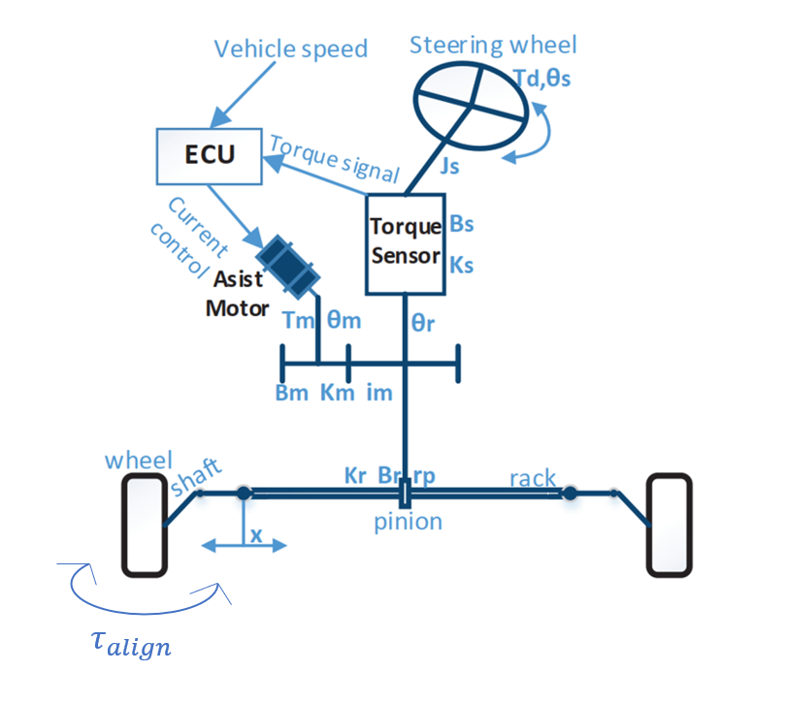
I. Introduction:
Goal of the project:
- Learning how to use MATLAB/Simulink with the Mass-Spring-Damper model.
- Contribution to an analysis of the dynamic behavior of the mechanical components of EPS system
- Analysis of the complete system dynamics of EPS, and implementation of the EPS simulation model on MATLAB/Simulink, with simulation results analysis.

Slide 4
I. Introduction:
Limitation:
This project skips on the effect of motor and effect of forces acting from road to EPS system through wheels.

Slide 5
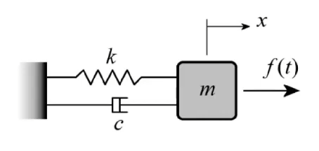
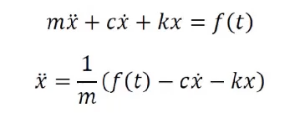
II. THEORETICAL BASICS:
2.1) Mass damper theory:
- x :displacement of the object
- Mass : m.
- Spring constant : k
Damping coefficient : c.
The function f(t): input to the system (depend on position, velocity, or time).
Notes:
So coming to the first part of the project that is to learn MATLAB/Simulink with mass-damper system model, and this is dynamic equation will be used for simulating later.

Slide 6
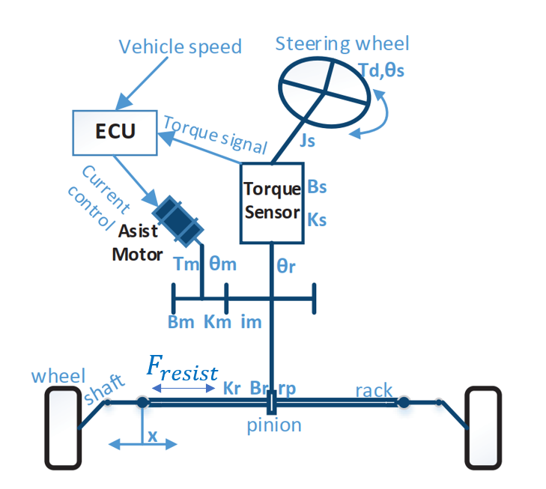
II. THEORETICAL BASICS:
2.2) Electric Power Steering Dynamic theory:
Notes:
Next part is about EPS model. With EPS model I separate it into 2 parts:
From steering wheel to lower steering column
From lower steering column to the rack

Slide 7
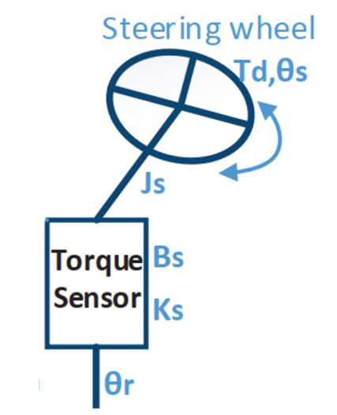
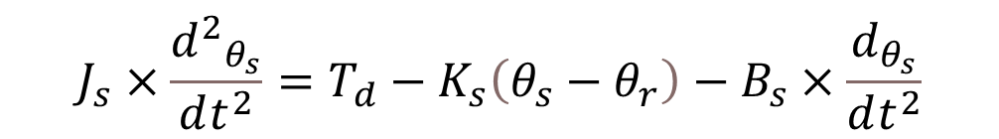
II. THEORETICAL BASICS:
2.2) Electric Power Steering Dynamic theory:
2.2.1) Steering column equation
The dynamic equations from the steering wheel to steering column
While:
J_{s}: Inertia of steering wheel and steering column (kg.m^2)
B_{s}: Viscous damping coefficient of steering column (Nm.[rad]^(-1))
K_{s}: Rigidity of torsional bar (Nm.[rad]^(-1))
θ_{s}: Turn angle of steering wheel (rad)
θ_{r}: Turn angle of output steering axle (rad)
T_{d}: Input torque of steering wheel (N.m)
Steering column equation :
$$J_{s}×\frac{{d^{2}}_{θ_{s}}}{dt^{2}}=T_{d}−K_{s}\left(θ_{s}−θ_{r}\right)−B_{s}×\frac{d_{θ_{s}}}{dt^{2}}$$
Notes:
First part is from steering wheel to lower steering column with dynamic equation on the right conner

Slide 8
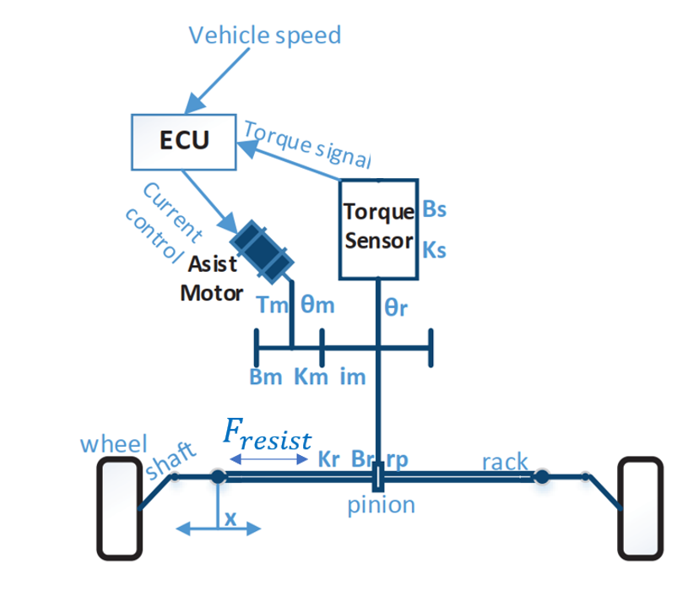
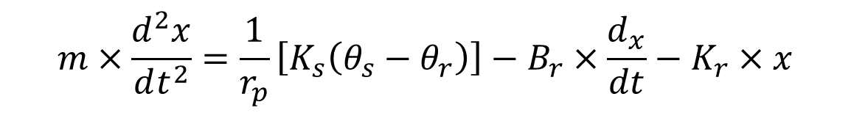
II. THEORETICAL BASICS:
2.2) Electric Power Steering Dynamic theory:
2.2.2) Rack and pinion dynamic
While:
m: mass of the pinion and rack (kg)
r_{p}: pinion radius (m)
B_{r}: Viscous damping coefficient of rack and pinion (Nm.[rad]^(-1))
θ_{r}: Turn angle of output steering axle (rad)
θ_{s}: Turn angle of steering wheel (rad)
K_{s}: Rigidity of torsional bar (Nm.[rad]^(-1))
x : displacement of rack (m)
Rack and pinion dynamic equation :
$$m×\frac{d^{2}x}{dt^{2}}=\frac{1}{r_{p}}\left[K_{s}\left(θ_{s}−θ_{r}\right)\right]−B_{r}×\frac{d_{x}}{dt}−K_{r}×x$$
Notes:
Second part is from lower steering column to rack and pinion and dynamic equation is on the right conner

Slide 9
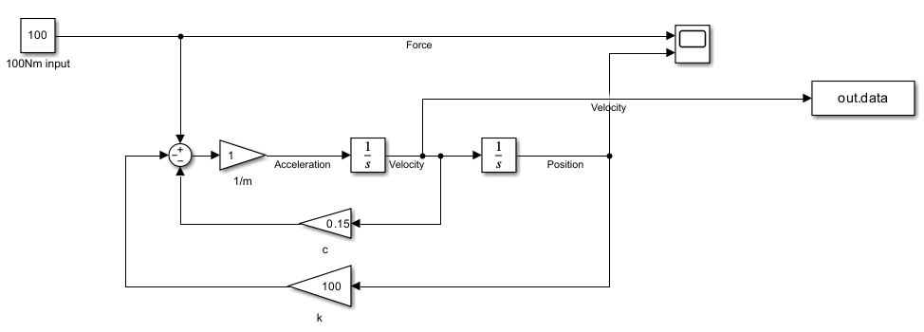
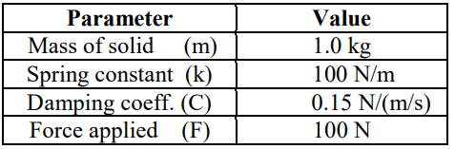
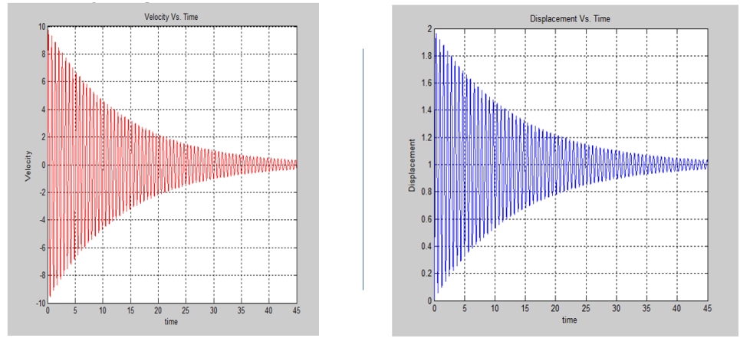
III. MATLAB/SIMULINK SIMULATION AND RESULT
3.1 : Mass – damper system
Notes:
With parameters is given, we transform equation into matlab environment then simulate and get result down below, both velocity and distance will fluctuate with amplitude is descending around a specific number

Slide 10
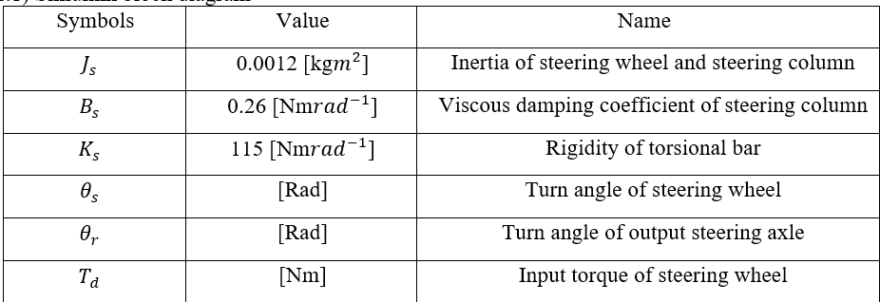
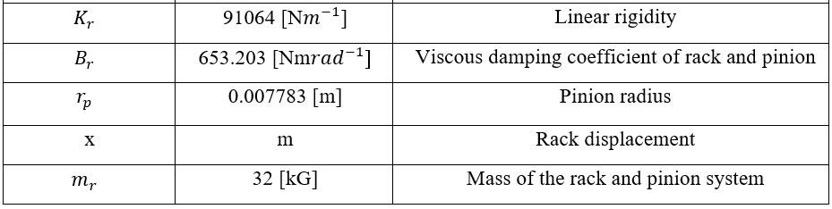
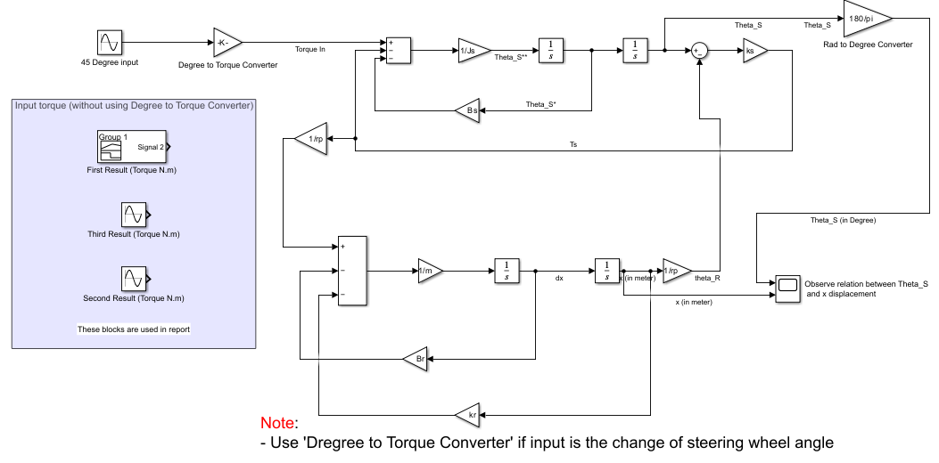
III. MATLAB/SIMULINK SIMULATION AND RESULT
3.2 EPS system
Notes:
This is a table of parameters I used when simulating. This is the layout of EPS system when transferred from equations into Simulink environment.

Slide 11
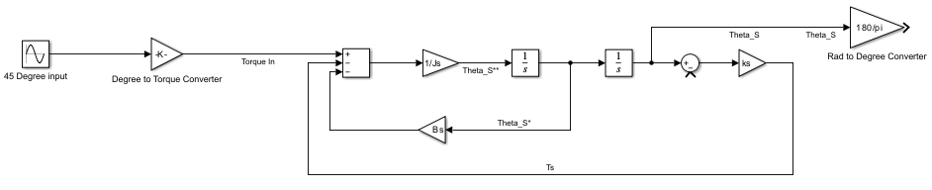
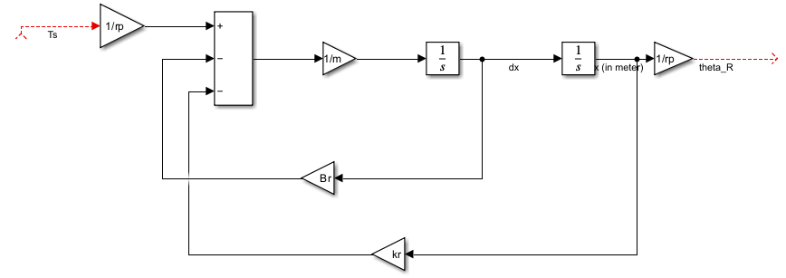
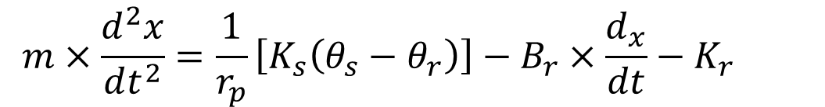
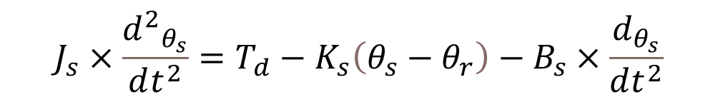
III. MATLAB/SIMULINK SIMULATION AND RESULT
3.2 EPS system
$$J_{s}×\frac{{d^{2}}_{θ_{s}}}{dt^{2}}=T_{d}−K_{s}\left(θ_{s}−θ_{r}\right)−B_{s}×\frac{d_{θ_{s}}}{dt^{2}}$$
$$m×\frac{d^{2}x}{dt^{2}}=\frac{1}{r_{p}}\left[K_{s}\left(θ_{s}−θ_{r}\right)\right]−B_{r}×\frac{d_{x}}{dt}−K_{r}×x$$
From steering wheel to lower steering column
2. From lower steering column to the rack
Notes:
To be specific, I apply 2 equations I mention above and combine them, we get complete simulation model that has been shown on previous slide

Slide 12
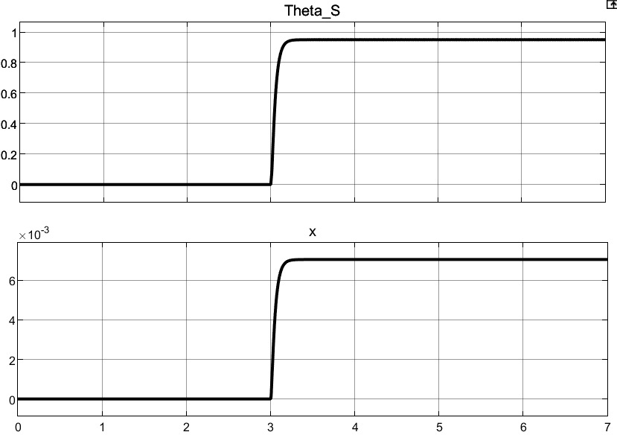
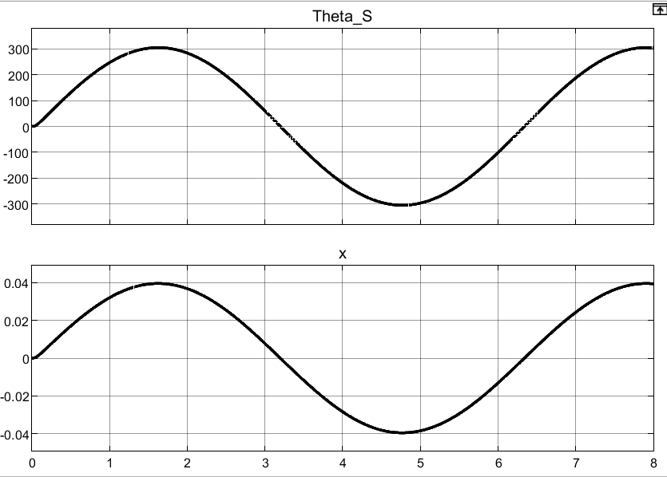
III. MATLAB/SIMULINK SIMULATION AND RESULT
3.2 EPS system
First result
Second result
First result: θS changed from 0 to nearly 1 rad, x jumped to approximately 7x10-3 m. Input torque at 3s is 5Nm
Second result, the input in steering wheel angle is generated in a sine shape which goes from -300 degrees to 300 degrees. The rack changed in sine shape also, going from -0.04m from center to 0.04m (positive direction goes from left to right)
Notes:
The inputs to this system are the torque or steering angle generated by the driver. Because we present a model of the power steering system, details of the tire dynamics are neglected. The outputs of the mechanical subsystem are the displacement of the rack, X, and the rotational displacement of the steering column θ_{S}. As we can see from First result, with θ_{S} changed from 0 to nearly 1 rad, x jumped to approximately 7x10⁻³ m. Input touque at 3s is 5Nm
In second result, the input in steering wheel angle is generated in a sine shape which goes from -300 degrees to 300 degrees. As we can see, the rack displacement also changed in sine shape also, going from -0.04m from center to 0.04m (positive direction goes from left to right)

Slide 13
VI/REFERENCES:
1. Cossalter, V. (2010). Motorcycle Dynamics. Lulu.
2. Genta. (2020). The automotive chassis. Springer International Publishing.
3. Hiremath, R. R., & Isha, T. B. (2019). Modelling and simulation of electric power steering system using permanent magnet synchronous motor. IOP Conference Series: Materials Science and Engineering, 561(1), 012124. https://doi.org/10.1088/1757-899x/561/1/012124
4. Jazar, R. N. (2008). Vehicle dynamics: Theory and applications. Springer.
5. Nasir, M. Z., Dwijotomo, A., Abdullah, M. A., Hassan, M. Z., & Hudha, K. (2012). Hardware-in-the-loop simulation for automatic rack and pinion steering system. Applied Mechanics and Materials, 229-231, 2135–2139. https://doi.org/10.4028/www.scientific.net/amm.229-231.2135

Slide 14
VI/REFERENCES:
6. Nemes, R.-O., Ruba, M., & Martis, C. (2018). Integration of real-time electric power steering system MATLAB/Simulink model into National Instruments Veristand Environment. 2018 IEEE 18th International Power Electronics and Motion Control Conference (PEMC). https://doi.org/10.1109/epepemc.2018.8521888
7. Pacejka, H. B. (2002). Tyres and vehicle dynamics. Butterworth-Heinemann.
8. Qun, Z., & Juhua, H. (2009). Modeling and simulation of the Electric Power Steering System. 2009 Pacific-Asia Conference on Circuits, Communications and Systems. https://doi.org/10.1109/paccs.2009.67
9. Ingale, A. (no date) “Modeling Mass-Spring-Damper System using Simscape,” Journal of Engineering Research and Application [Preprint]. Available at: https://doi.org/10.9790/9622-0801033033.
10. Sh., A., H., E. and A., E.-H. (2006) “Side-stick control of power rack and pinion steering system,” The International Conference on Applied Mechanics and Mechanical Engineering, 12(12), pp. 383–396. Available at: https://doi.org/10.21608/amme.2006.41261.

Slide 15


Thank you for listening!
Have a nice day

Slide 16
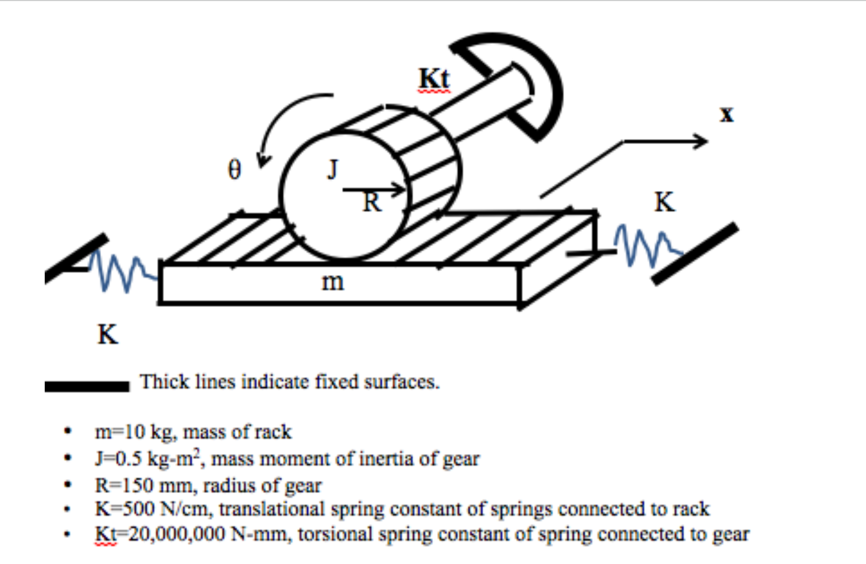
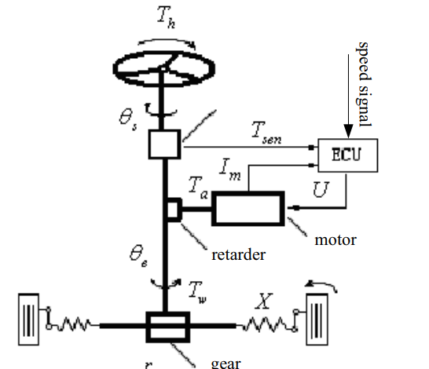
Sample Model Our model

Slide 17
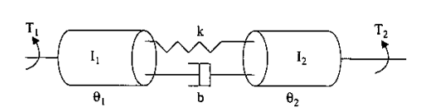


Torsion bar
For the system shown above, we can write equations for disk 1 and disk 2

Slide 18
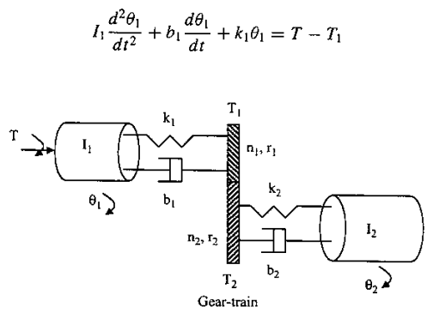
Gear train

